Slide 1



LISP: The Language That Thinks in Lists
Discover the elegant programming language that revolutionised artificial intelligence and still shapes how we think about code today.
By
Sai Ganesh Bh
Asst. Professor
Aditya University

Slide 2




A Brief History
What Is LISP?
LISP is a programming language created in 1958 by John McCarthy. It was designed specifically for artificial intelligence research, helping computers tackle thinking-like tasks such as understanding language, solving complex problems, and reasoning logically.
AI Research
Natural language processing
Today, LISP remains vital because it excels at working with symbols, logic, and AI concepts—making it fundamentally different from languages like C, Java, or Python.
Problem Solving
Complex logical reasoning
Symbolic Computing
Manipulating abstract concepts

Slide 3



Why "LISP"?
1
LISt Processor
The name reveals the language's core philosophy: everything revolves around lists.
2
Programs Are Lists
In LISP, your code itself is written as lists—blurring the line between data and instructions.
3
Data Are Lists
Nearly every structure you work with is represented as a list, creating remarkable consistency.
This fundamental design choice makes LISP beautifully different from other programming languages—and surprisingly powerful for AI and symbolic reasoning.

Slide 4
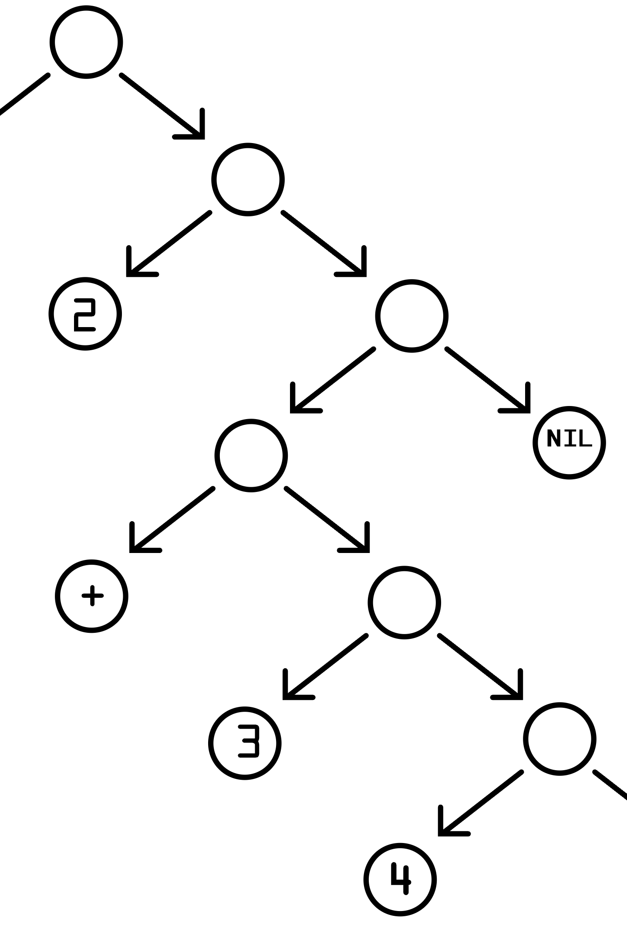

Understanding LISP's Structure
LISP programs are built from S-expressions (symbolic expressions)—tree-like structures where each node can be either an atom or another list. This recursive nature allows for elegant representation of complex hierarchies and relationships.

Slide 5
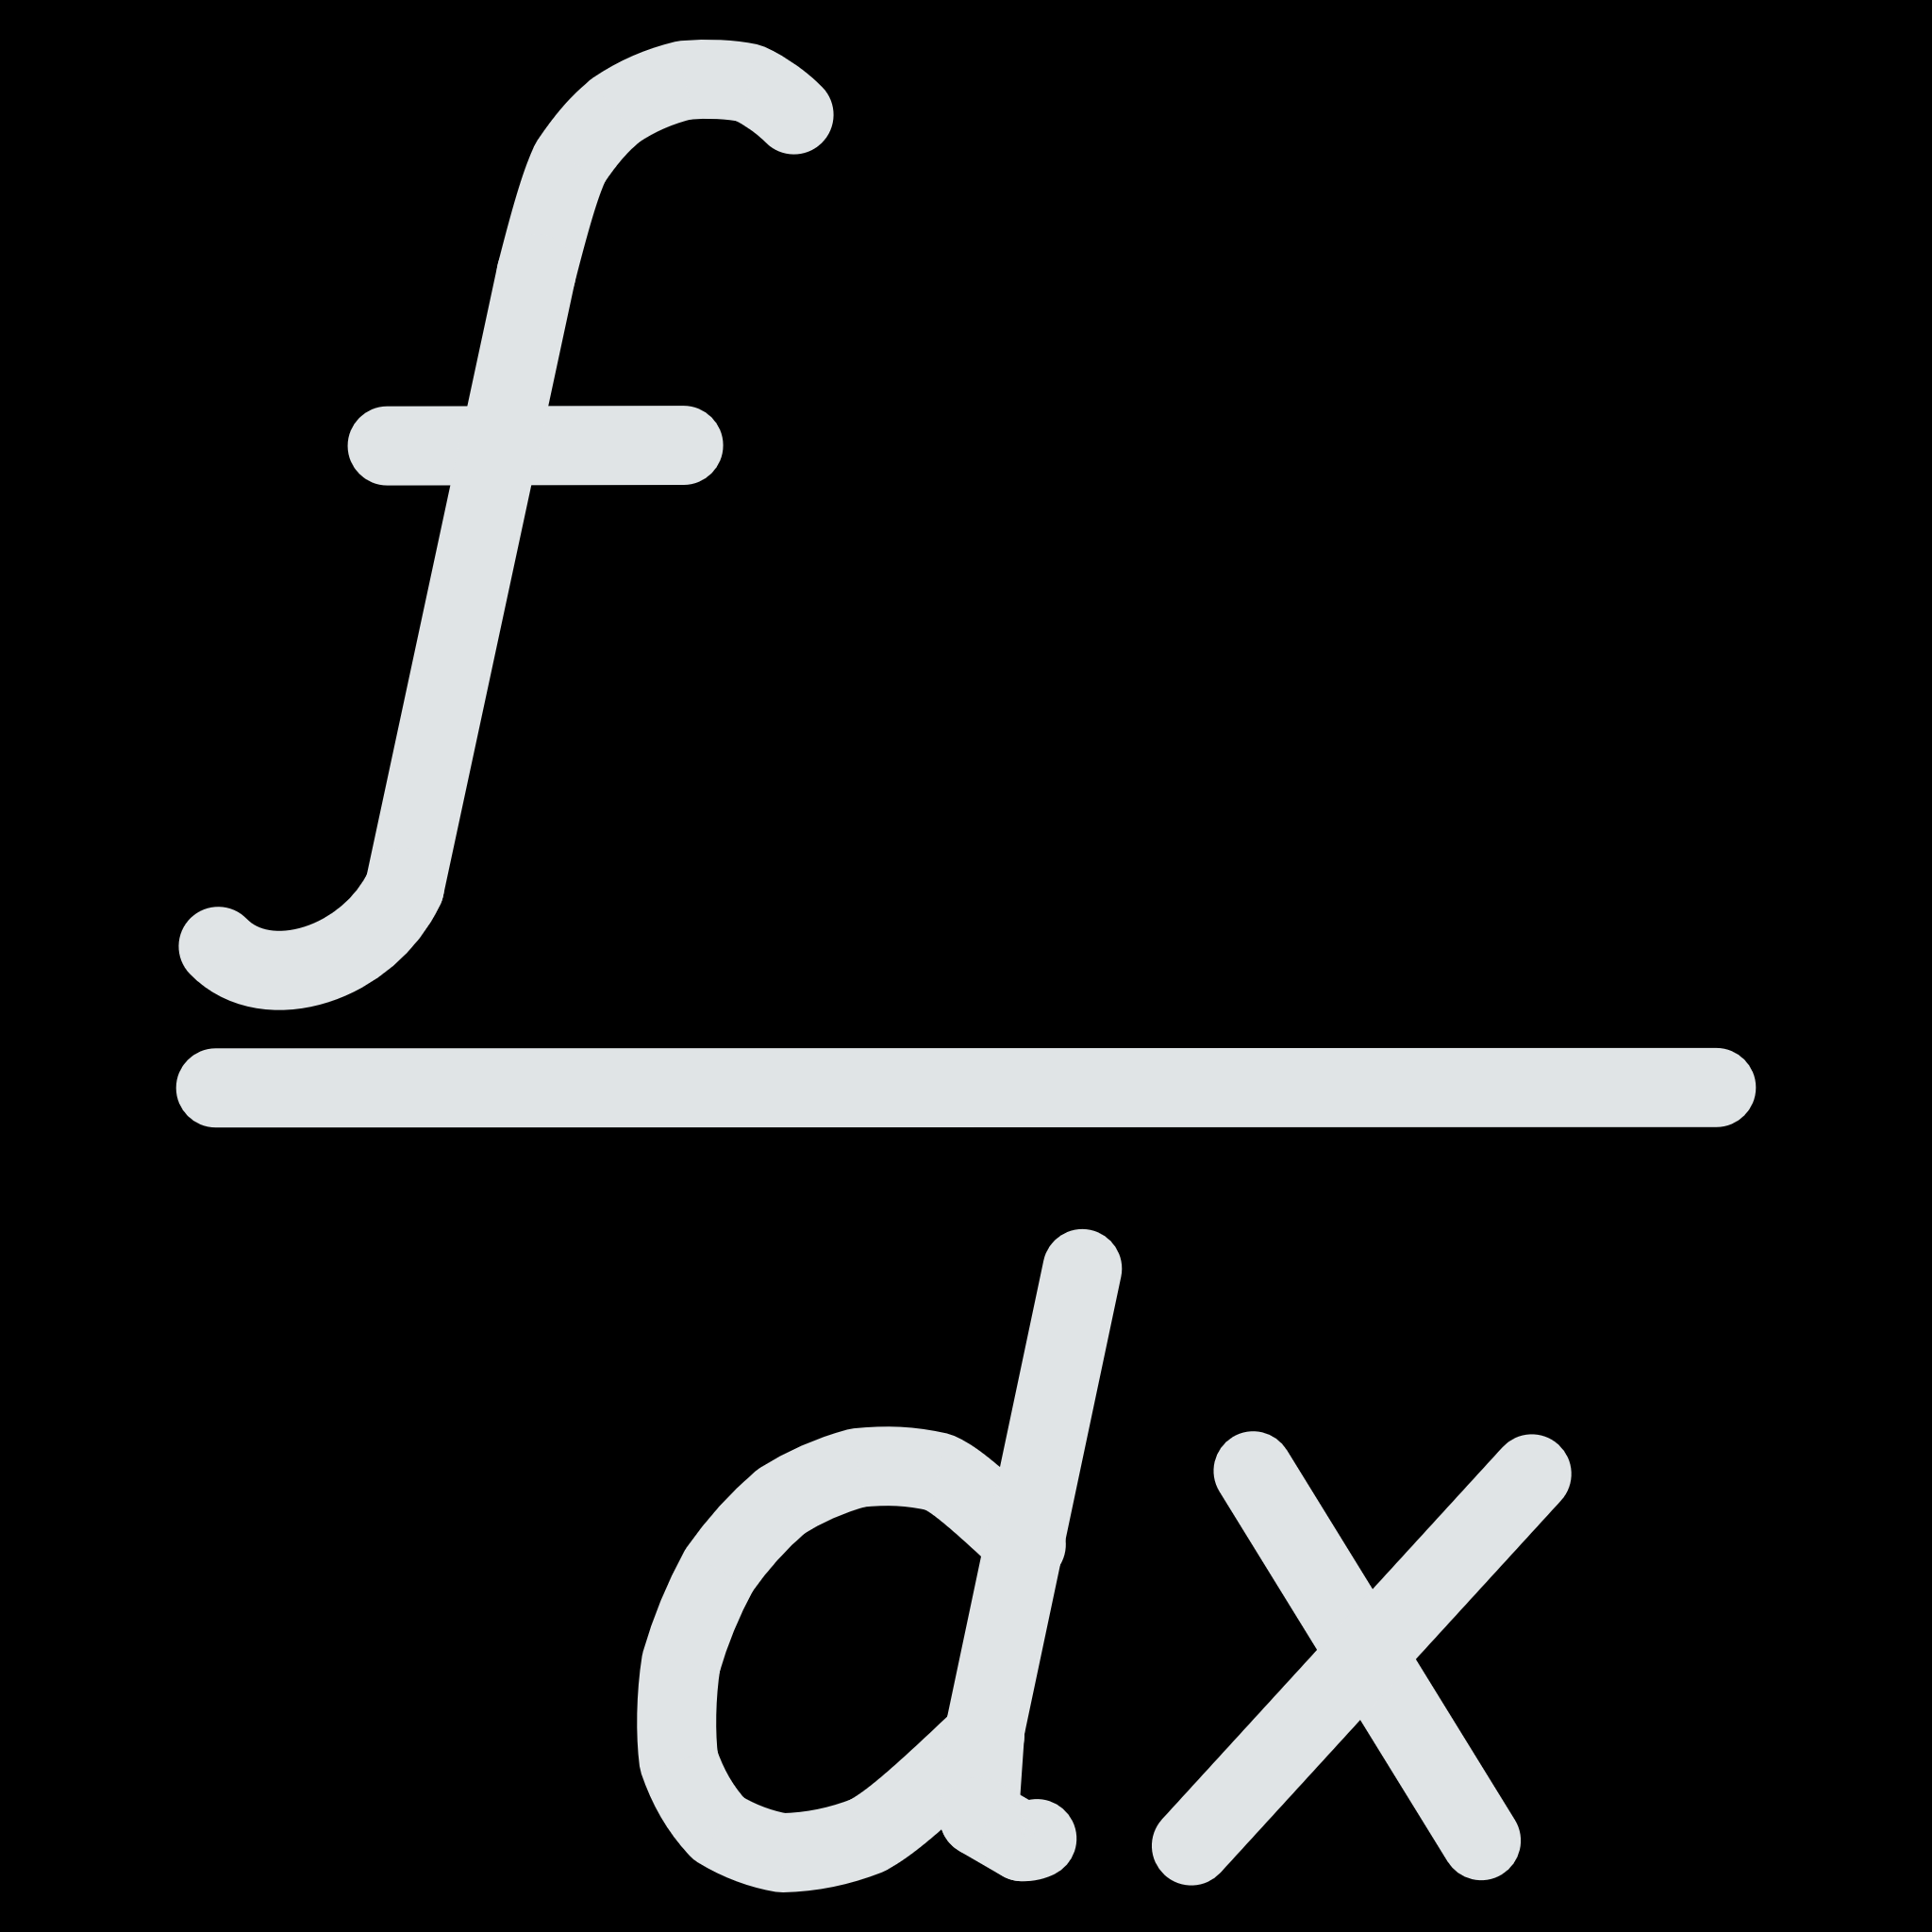


The Visual Language
How LISP Looks
LISP uses parentheses everywhere. This might seem odd at first, but it creates a perfectly consistent syntax.
Traditional Maths
The pattern is always:
5 + 3
(function input1 input2 ...)
LISP Syntax
This is called prefix notation—the operator comes first, followed by its arguments.
(+ 5 3)
Both expressions mean "add 5 and 3", but LISP's version makes the operation explicit and uniform.

Slide 6



The Building Blocks
LISP programmes are wonderfully simple—they're constructed from just two fundamental elements:
Atoms
Single, indivisible elements
Numbers: 10, 3.14
Symbols: hello, x
Strings: "ChatGPT"
Lists
Groups enclosed in parentheses
(1 2 3)
(a b c)
(+ 2 3)
That's the entire foundation. Everything you build in LISP—from simple calculations to sophisticated AI systems—combines these two elements.

Slide 7


The Revolutionary Power of Lists
Code as Data, Data as Code
LISP's list-based structure creates something remarkable: homoiconicity. Because programmes are written as lists—the same structure used for data—LISP can:
Treat programmes like data
Manipulate data like programmes
Write code that generates more code
This makes LISP extraordinarily powerful for artificial intelligence, language analysis, and metaprogramming—where programmes modify themselves.

Slide 8


Getting Started
Basic LISP Examples
1
Addition
(+ 2 2)
Returns 4
2
Multiplication
(* 3 4)
Returns 12
3
Comparison
(> 7 3)
Returns true
4
Variable
(setq x 10)
Assigns 10 to x
5
Function
(defun square (n) (* n n))
Defines a squaring function

Slide 9

Lists manipulation methods
Function | Meaning
car | return first element (head)
cdr | return rest of the list (tail)
cons | add an element to the front of a list
list | create a new list
append | join lists together
null | check if list is empty
caar | car of car
cadr | car of cdr (second element)
cdar | cdr of car
cddr | cdr of cdr (list after first two elements)

Slide 10




Why LISP Still Matters
Elegant Simplicity
Minimal syntax, maximum expressiveness
Timeless Concepts
Ideas that influenced generations of languages
AI Foundation
Still relevant for cutting-edge research
LISP taught us that code doesn't need to be complicated to be powerful—sometimes, the most revolutionary ideas come from thinking differently about the fundamentals.

